Slide 1
Analyze CNN_GAP & Training on noisy signals
Speaker: Yu-Cheng Lin
Advisor: Prof. An-Yeu Wu
Date: 2019/12/5

Slide 2
Outline
Analysis on the model, different training procedure
Add noisy signal and train it
Fine tuning on pre-trained model
WCE v.s. F1-loss
Training with F1-loss
Conclusion
Future work
Some bug in my code

Slide 3
Different Training procedure (1/3)
Feature extraction (FE)
Feature selection (FS)
IN
AVG
OUT
Model1
Joint | FE
Model2
 |  |  | FS
Model3
Model4
Model5
Notes:
Why? Check if the interpretation of FE and FS are correct based on the comparison of different training procedure

Slide 4
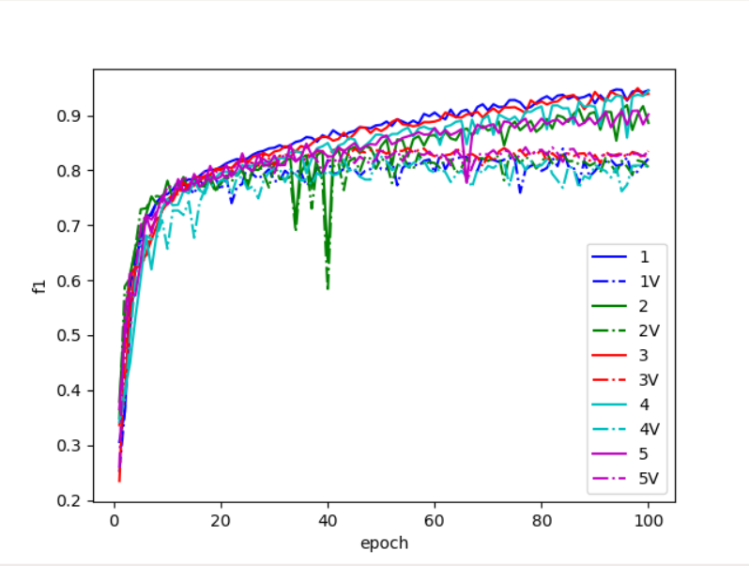
Different Training procedure (2/3)

Slide 5
Different Training procedure (3/3)
No significant relation of different procedure
Procedure 1 converges a little bit faster than 3 (2FE+jointly is better)
Highest validate f1-score 0.840

Slide 6
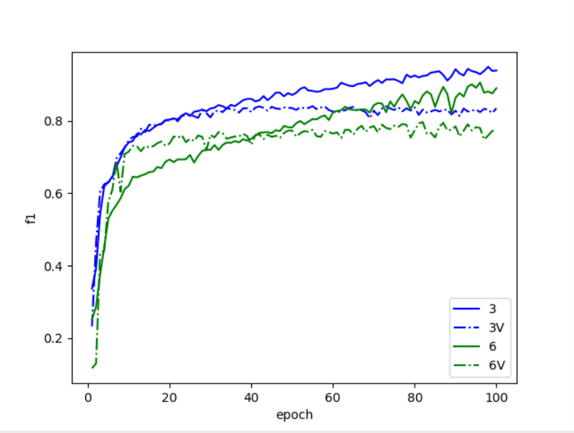
Add ~ type and train jointly (1/2)
* Model3: 3-type
* Model6: 4-type

Slide 7
Add ~ type and train jointly (2/2)
Best validate F1: 0.796
Poor performance
What about fine-tuning based on pre-trained model3 + one neuron?
Lower overhead compare with CL3SN

Slide 8
Add ~ and training on N/A/O – pre-trained model (1/3)
Load the best pre-trained model of model 3
Add a neuron for in the last layer
Train the whole model with 0.1 times of the original learning rate (Fine tuning)

Slide 9
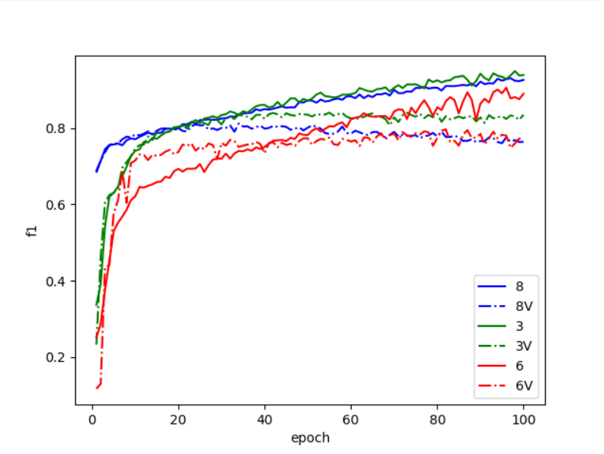
Add ~ and training on N/A/O – pre-trained model (2/3)
Best f1: 0.812 @ epoch34
* Model3: 3-type
* Model6: 4-type
* Model8: 4-type, fine-tuning model3

Slide 10
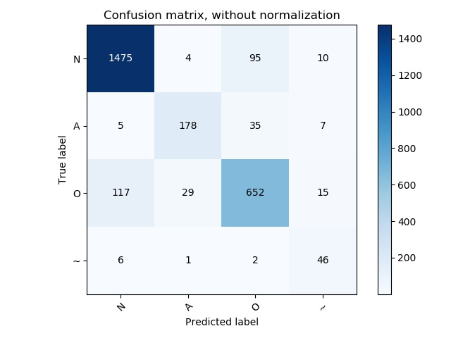
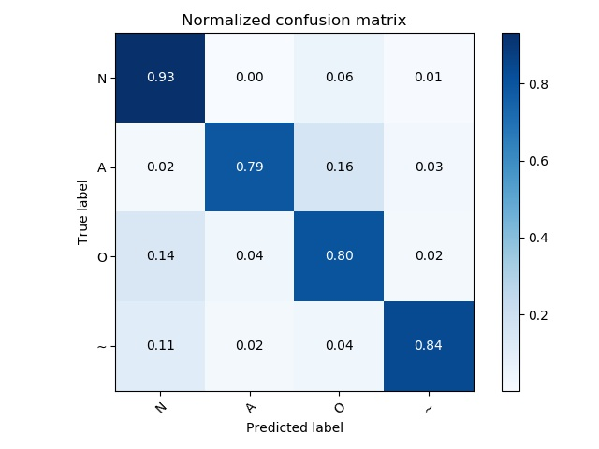
Add ~ and training on N/A/O – pre-trained model (3/3)
High recall but Low precision in type ~

Slide 11

WCE v.s. f1-loss (1/2)
 | Pred 0 | Pred 1
True 0 | TP | FN
True 1 | FP | TN
WCE = CE*weight
Weight = 1/True
CE = TP
So,
WCE = TP/(TP+FN)
=precision
Recall=TP/(TP+FN)
Precision=TP/(TP+FP)
1/F1=1/Recall+1/Precision
* The only difference is that in pytorch CrossEntropyLoss
criterion, it pass through log-soft-max layer then nll-loss.
* However, log-soft-max will cause sum in dim 1 not equal to 1, which can’t represent probabilistic in intuition.
* So I choose soft-max layer in calculating f1-loss.

Slide 12
WCE v.s. f1-loss (2/2)
Poor Precision cause F1 score=0.812 in model8
Seems good?

Slide 13
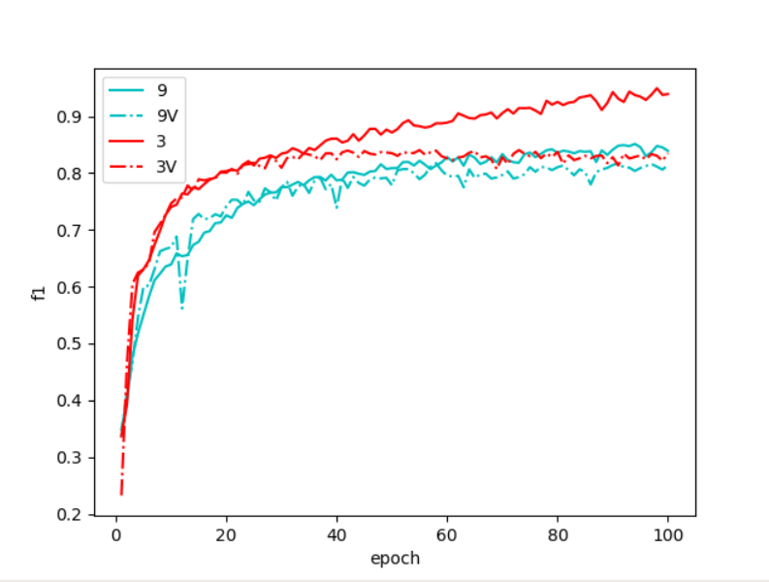
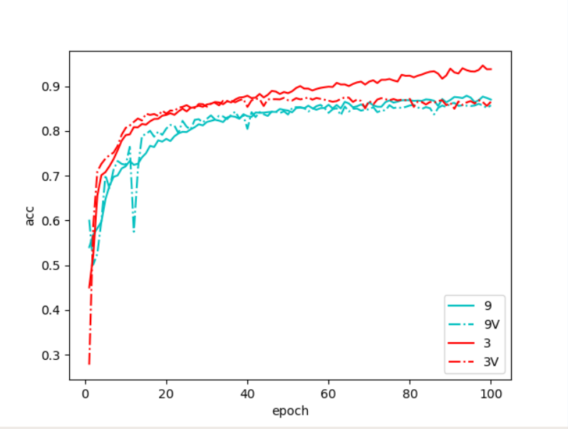
Training with F1-loss (1/9)
F1 loss is hard to train!!! Reduce dropout => model 12
F1 loss
Acc
Notes:
MODEL 9 F1: 0.817

Slide 14
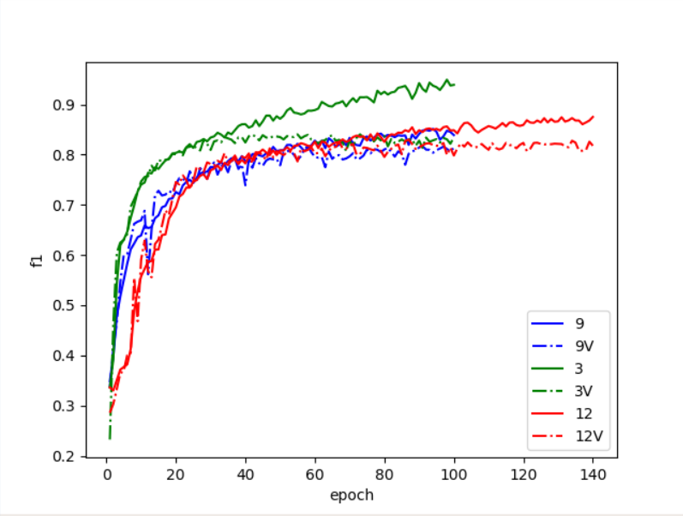
Training with F1-loss (2/9)
Best F1 score: 0.840
Con verge slower in the first 30 epoch and faster after 30 epoch? Why?
* Model3: WCE loss (0.84)
* Model9: F1 loss, dropout 0.3 (0.817)
* Model12: F1 loss, dropout 0.1 (0.84)

Slide 15

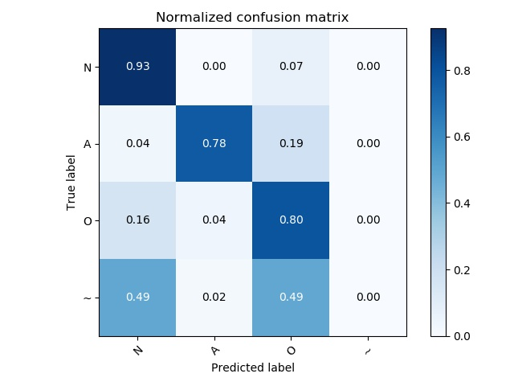
Training with F1-loss (3/9)
Result of model12

Slide 16

Training with F1-loss (4/9)
Why?
Model 3
Model 12

Slide 17
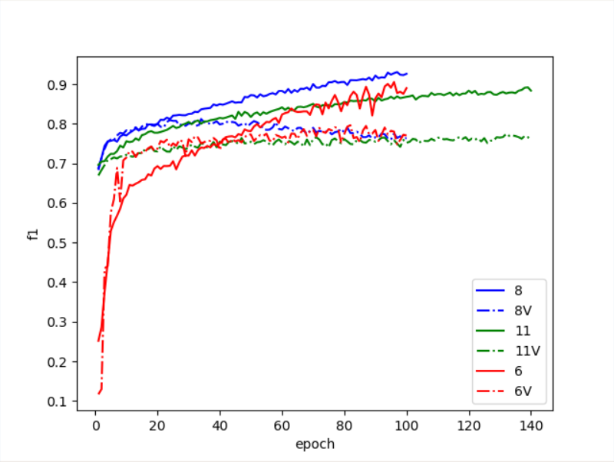
Training with F1-loss (5/9)
Add noisy and fine tuning with 1e-4 lr => Model 11
Fine-tuning on model 12 (training by f1-loss) has poor performance.
Why?
* Model 6: directly train 4 type (0.796)
* Model 8: fine tune model 3 (0.812)
* Model 11: fine tune model 12 (0.774)
Notes:
用F1去train反而更低?

Slide 18
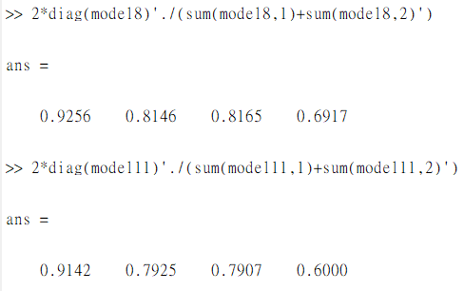

Training with F1-loss (6/9)
Model 8
Model 11
Notes:
不只每一類變爛，而且noisy變超爛

Slide 19
Training with F1-loss (7/9)
Observation & interpretation:
F1 = 2 * P * R / (P+R)
R is easy to train
P is hard to train
Since F1 put more importance on the smaller value, it converges slow!!!
What about fine-tuning model 8 with f1-loss?

Slide 20
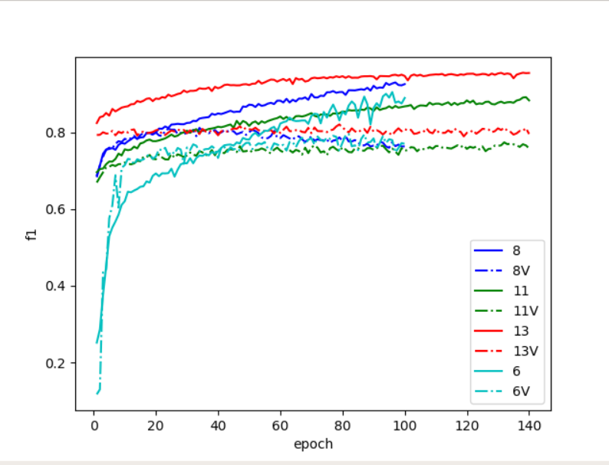
Training with F1-loss (8/9)
* Model6: directly train 4 type(0.796)
* Model8: tune model3 with WCE(0.812)
* Model11: tune model12 with f1(0.774)
* Model13: tune model3 with f1(0.821)

Slide 21
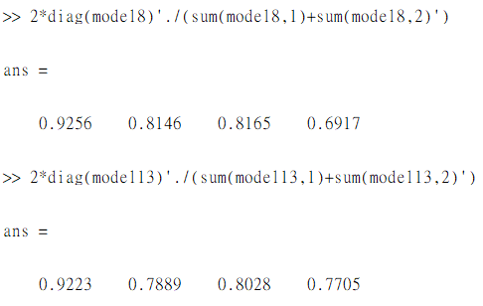

Training with F1-loss (9/9)
Model 8
Model 13
Notes:
Very good improvement in F1 of ~ type

Slide 22
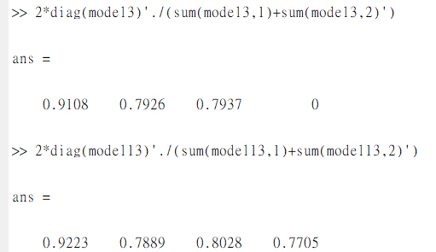
Conclusion
Fine tuning on pre-trained model on N/A/O has better performance
F1 & precision is hard to train than recall (Explain? CAM?)
Best performance of 3-type
WCE, 3-type or F1, 3-type >>> [F1: 0.84]
Best performance of 4-type
WCE, 3-type => WCE, tuning 4-type => F1, tuning 4-type >>> [F1:0.821]

Slide 23
Future work
Analyze which the signal that cause low precision in ~ type & O type

Slide 24
Some bug in my code
Originally 3 type & train test split
But train test split on 4 type and apply pre-trained model might cause error
Split noisy signal separately and concatenate with the other types

